Slide 1

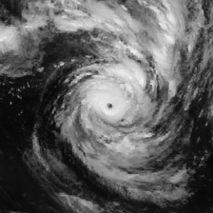
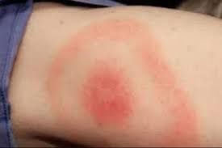
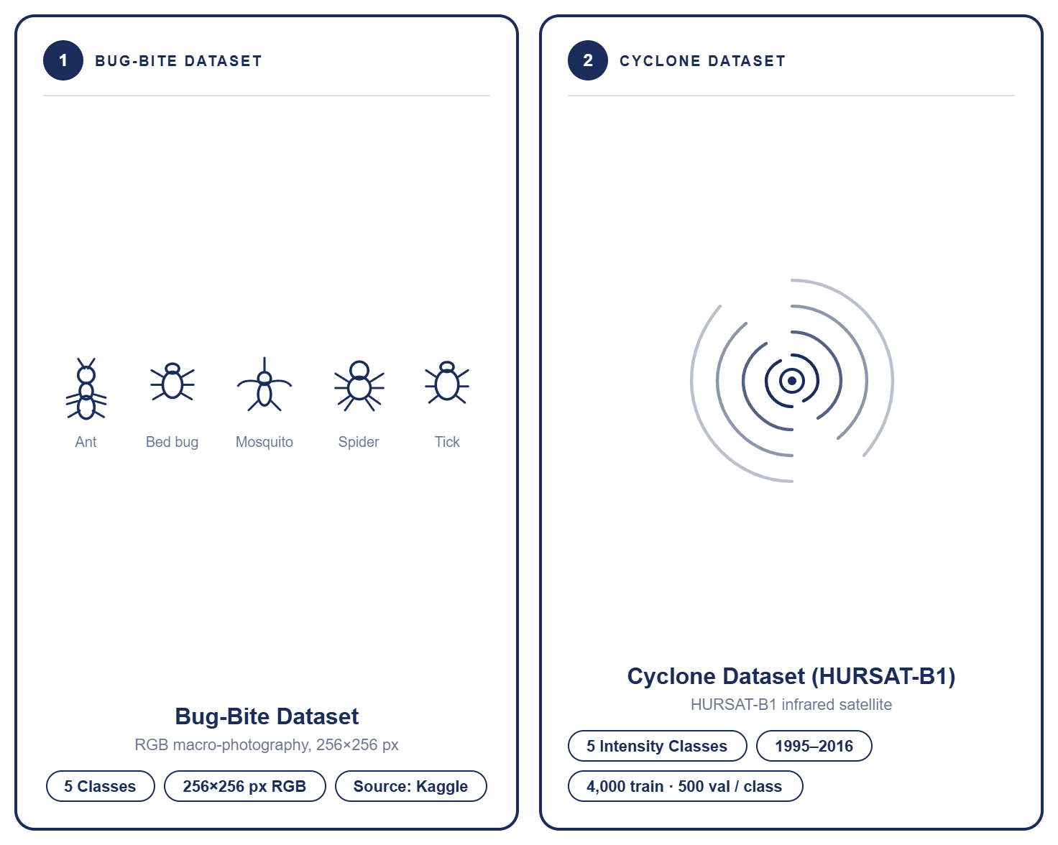
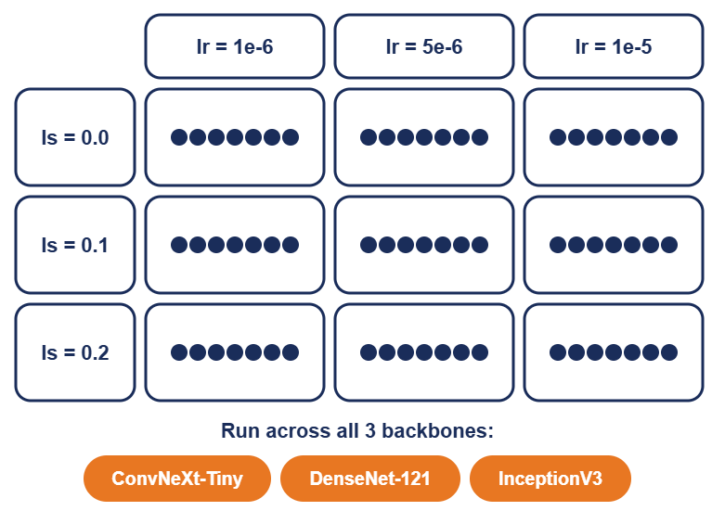
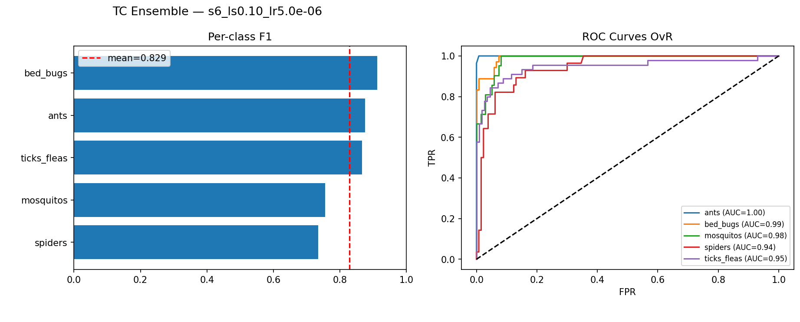
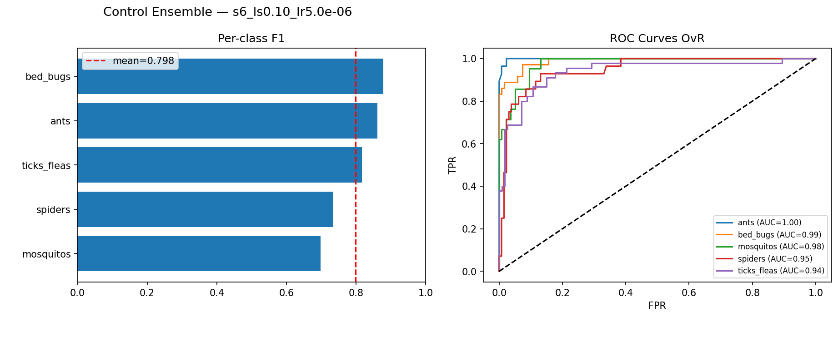
Bug bite classification using a CNN based TC classification model
Elena Krener, Dan Lemberg, Ishay Yulzary and Natan Trostianitser
26-1-R-26
INTRODUCTION
Diagnosing insect bites is a persistent clinical challenge. Five distinct bite classes produce visually similar skin lesions, often forcing physicians into subjective assessment and delaying targeted treatment. As shown below, tropical cyclone satellite imagery shares striking morphological properties with bite lesions, motivating our cross-domain transfer learning approach
Figure 1: Morphological Analogy: Tropical Cyclone (IR Satellite) vs. Tick Bite (Erythema Migrans)
1
DATASET & ARCHITECTURE
Figure 2: Training Datasets – Bug Bites and Cyclones
Figure 3: Experiment Pipeline Architecture
Bug-Bite Dataset: Source: Kaggle. 5 classes: ants, bed bugs, mosquitos, spiders, ticks/fleas. Split: 80% train / 20% val.
Cyclone Dataset (HURSAT-B1): Source: NOAA + IBTrACS. 5 Saffir-Simpson intensity classes. Up to 4,000 train / 500 val per class.
2
EXPERIMENTAL DESIGN
3
RESULTS & FINDINGS
Methodology: 63 controlled experiments across Control and TC Transfer pipelines to isolate the effect of cyclone pre-training.
Variables Tested: Label Smoothing, Learning Rate, and Random Seed, swept across three backbone architectures.
Figure 4: Hyperparameter sweep grid - TC pre-training phase only
Best Performance: TC ensemble reached 84.2% accuracy and 97.3% ROC-AUC at optimal config (seed 6, ls=0.1, lr=5e-6), a 3.2% gain over Control.
Hyperparameter Sensitivity: ls=0.1 and lr=5e-6 were optimal; wrong settings can reverse the TC advantage.
Ensemble Robustness: Soft-voting across all three backbones held ROC-AUC above 97% in both pipelines
Figure 5: Performance comparison between control and TC-Pretrain ensembles
4
TRANSFER LEARNING IMPACT
TC Transfer pipeline outperformed Control by 3.2% accuracy at optimal hyperparameters
Balanced accuracy gap confirms TC gains are real, not class-imbalance artifacts
Hyperparameter Sensitivity: TC advantage only holds at the right lr and label smoothing; wrong settings flip the result.
Consistent Discriminability: Both pipelines exceeded 97% ROC-AUC across all configurations.
Metric | Control | TC Transfer
Validation Acc. | 81.0% | 84.2%
Balanced Acc. | 80.1% | 83.6%
ROC-AUC | 97.0% | 97.3%
MCC | 0.762 | 0.802
Config Type | Config | TC Acc. | Control Acc. | Delta
Best | Seed 6, ls=0.10, lr=5e-6 | 84.2% | 81.0% | +3.2%
Median | Seed 6, ls=0.10, lr=1e-5 | 82.3% | 81.0% | +1.3%
Control | Seed 3, ls=0.20, lr=1e-5 | 82.3% | 82.3% | +0.0%
Worst | Seed 2, ls=0.00, lr=1e-6 | 80.4% | 81.6% | -1.2%
Figure 6: Comparison of key performance metrics between the Control and TC Transfer ensembles at optimal configuration.
Figure 7: Representative experimental configurations: best-performing, median, worst-performing TC Transfer result, and a case where Control outperformed TC.
CONCLUSION & FUTURE WORK
TC pre-training on cyclone satellite imagery demonstrably improved bug-bite classification, with the optimal TC Transfer ensemble achieving 84.2% accuracy and 97.3% ROC-AUC, a 3.2% accuracy gain over the Control ensemble, validating the cross-domain structural similarity hypothesis.
Future work will focus on expanding the bug-bite dataset to address per-class imbalance, exploring attention-based backbones (e.g., Swin Transformer) as TC pre-training targets, and conducting clinical validation with dermatologist ground truth.
Figure 1: Design Thinking Methodology.
Figure 2: The final panel.

